Slide 1

Chapter 1: Introduction
1.1 Introduction to SAS Enterprise Miner

Slide 2
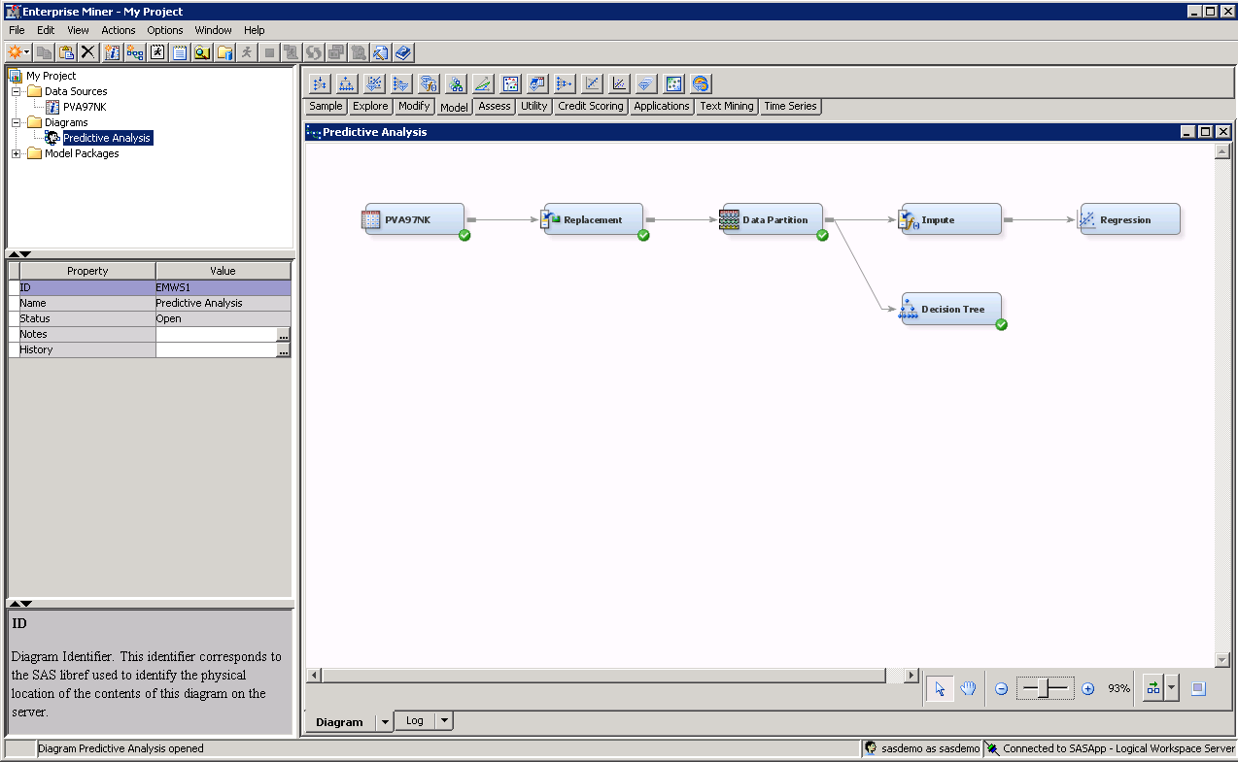
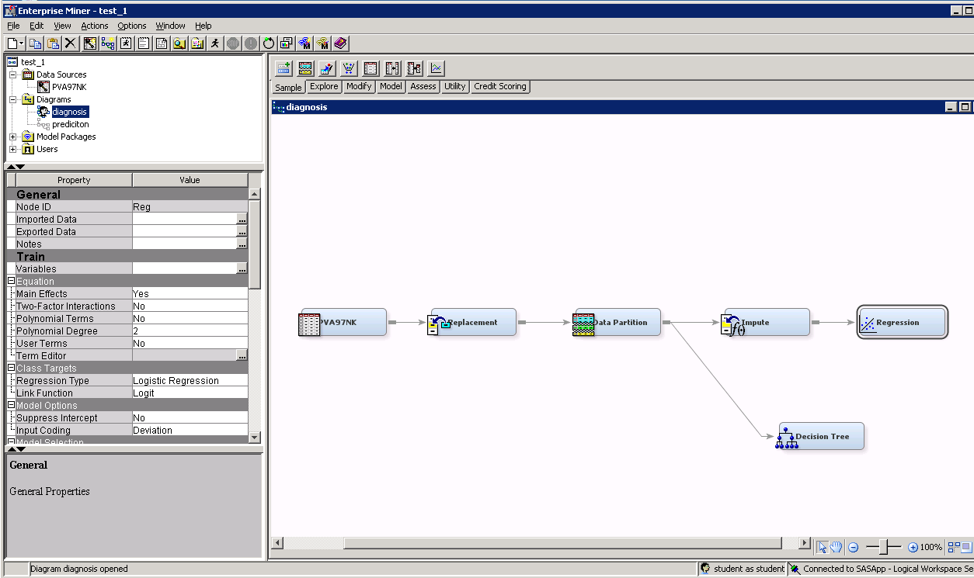
SAS Enterprise Miner

Slide 3
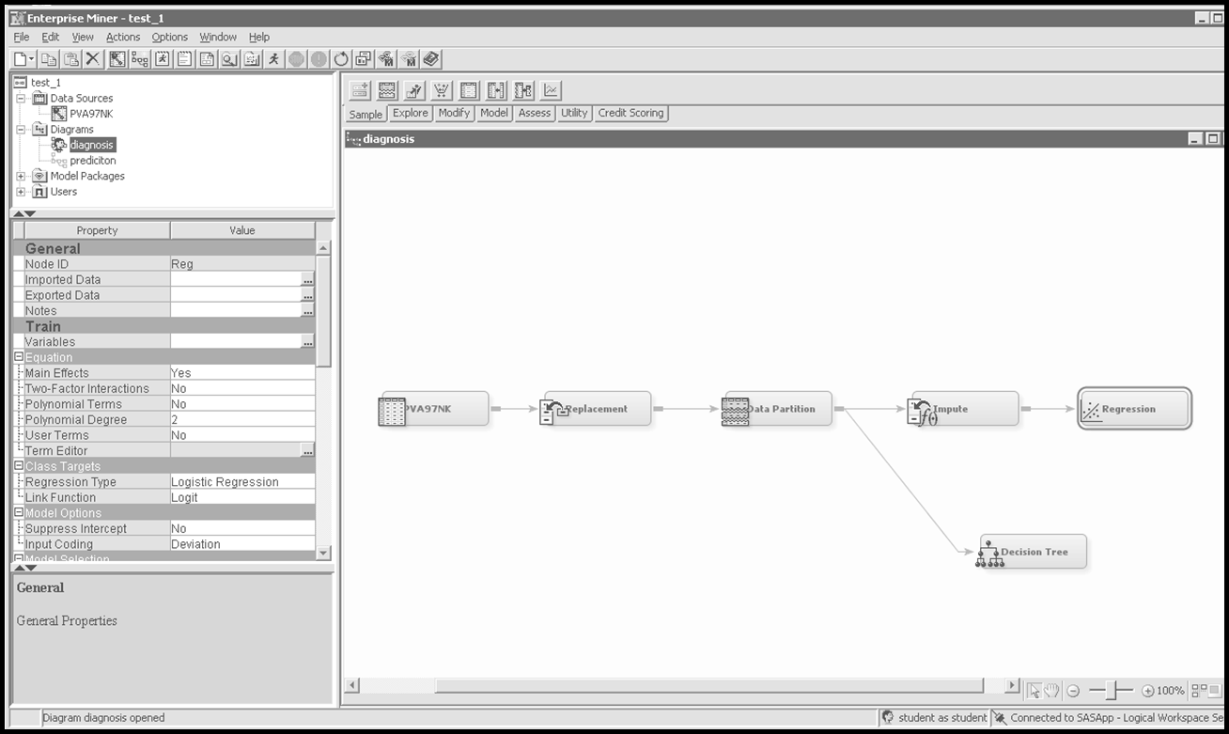

SAS Enterprise Miner – Interface Tour
Menu bar and shortcut buttons

Slide 4

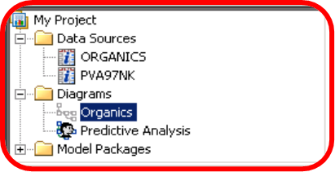
SAS Enterprise Miner – Interface Tour
Project panel

Slide 5

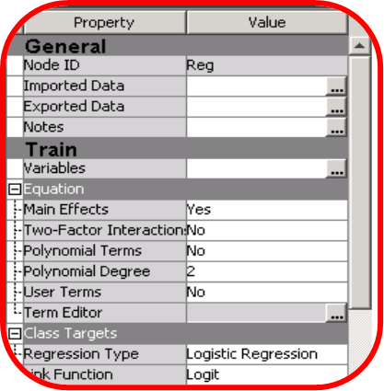
SAS Enterprise Miner – Interface Tour
Properties panel

Slide 6
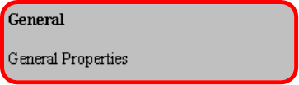
SAS Enterprise Miner – Interface Tour
Help panel

Slide 7
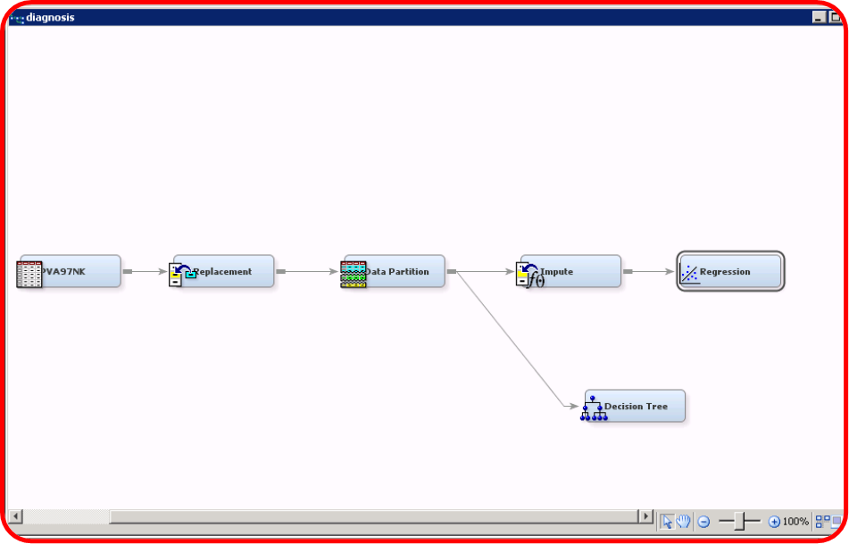
SAS Enterprise Miner – Interface Tour
Diagram workspace

Slide 8
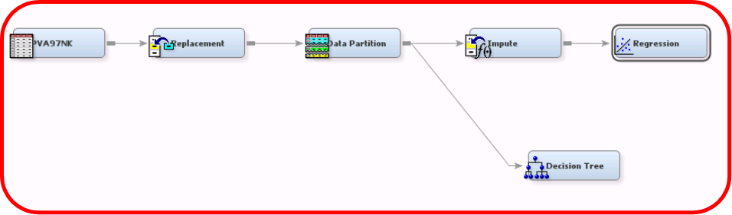
SAS Enterprise Miner – Interface Tour
Process flow

Slide 9

SAS Enterprise Miner – Interface Tour
Node

Slide 10

SAS Enterprise Miner – Interface Tour
SEMMA tools palette

Slide 11
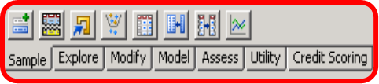
SEMMA – Sample Tab
• Append
• Data Partition
File Import
• Filter
• Input Data
• Merge
• Sample
• Time Series

Slide 12

SEMMA – Explore Tab
• Association
• Cluster
• DMDB
• Graph Explore
• Market Basket
• Multiplot
• Path Analysis
• SOM/Kohonen
• StatExplore
• Variable Clustering
• Variable Selection

Slide 13

SEMMA – Modify Tab
• Drop
• Impute
• Interactive Binning
• Principal Components
• Replacement
• Rules Builder
• Transform Variables

Slide 14

SEMMA – Model Tab
• AutoNeural
• Decision Tree
• Dmine Regression
• DMNeural
• Ensemble
• Gradient Boosting
Least Angle Regression
• MBR
• Model Import
• Neural Network
• Partial Least Squares
• Regression
• Rule Induction
• Support Vector Machines
• Two Stage

Slide 15

SEMMA – Assess Tab
• Cutoff
• Decisions
• Model Comparison
• Score
• Segment Profile

Slide 16

Beyond SEMMA – Utility Tab
• Control Point
• End Groups
• Ext Demo
• Metadata
• Reporter
• SAS Code
• Start Groups

Slide 17

Credit Scoring Tab (Optional)
• Credit Exchange
• Interactive Grouping
• Reject Inference
• Scorecard

Slide 18
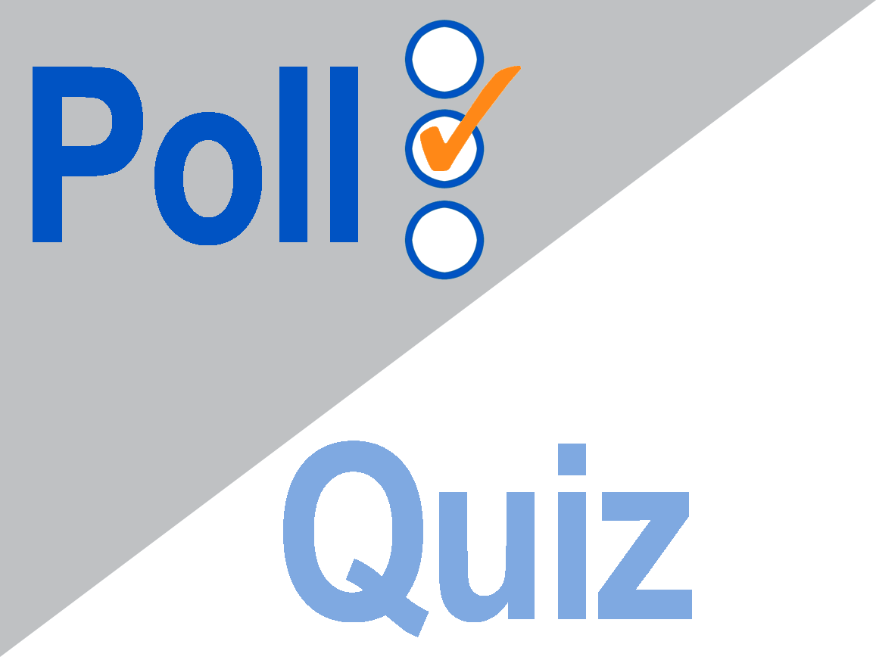

Slide 19
1.01 Poll
Tools under the Sample tab change the number of columns of the data, whereas tools under the Modify tab change the number of rows.
 True
 False
Notes:
Type answer here

Slide 20
1.01 Poll – Correct Answer
Tools under the Sample tab change the number of columns of the data, whereas tools under the Modify tab change the number of rows.
 True
 False
Notes:
Type answer here

Slide 21
The Analytic Workflow
Analytic workflow
Select cases
Apply analysis
Gather results
Extract input data
Repair input data
Validate input data
Transform input data
Integrate deployment
Define analytic objective
Refine analytic objective
Assess observed results
Generate deployment methods

Slide 22
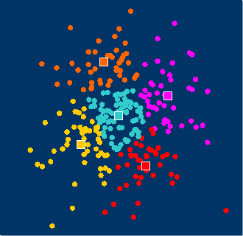
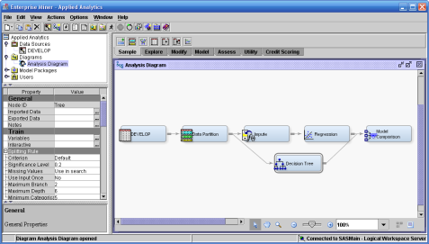

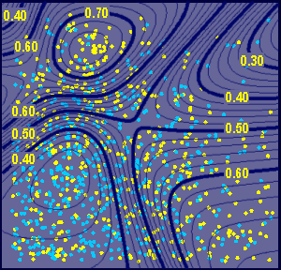
SAS Enterprise Miner Analytic Strengths
Pattern Discovery
Predictive Modeling

Slide 23




Applied Analytics Case Studies
Bank usage segmentation
Web services associations
Credit risk scoring
University enrollment prediction

